Slide 1
AANSA PHARMA
Revolutionizing Pharmacy Services in Nepal
PRESENTED BY:
NISHAN KARKI
PRAJWAL BASTOLA
SANJAY NEPALI
Notes:
Good [morning/afternoon], everyone. Today, I'm excited to introduce you to Aansa Pharma, a revolutionary mobile app that is transforming how pharmacy services are delivered in Nepal."

Slide 2
INTRODUCTION
Aansa Pharma
The world is going digital, but pharmacy services in Nepal are still mostly offline.
Aansa Pharma aims to make pharmacy access faster, safer, and more convenient.
Offers a mobile solution to order medicines, consult pharmacists, and request emergency help.
Notes:
: Introduction "As we all know, Nepal's digital shift is rapid, yet the healthcare and pharmaceutical sectors are still catching up. Aansa Pharma steps in as a smart solution to digitize pharmacy services and make them more accessible and user-friendly."

Slide 3
PROBLEM STATEMENT
1
2
3
Aansa Pharma
Lack of trusted online pharmacy platforms in Nepal.
No system for certified pharmacist consultation .
Difficulty during emergencies and pandemics.
Notes:
Problem Statement "Let me outline the key challenges. Firstly, people still have to physically visit pharmacies, which isn’t always safe or convenient. There’s also no trusted online platform with certified pharmacist consultation, and rural areas lack proper pharmacy access. These gaps became even more visible during emergencies like COVID-19."

Slide 4
OBJECTIVES
Aansa Pharma
Mobile app for ordering verified medicines.
Video or chat consultations with male/female pharmacists.
Emergency home visit service.
Multilingual and user-friendly design.
Notes:
Our Solution – Aansa Pharma "Aansa Pharma is a mobile app designed to address these issues. It allows users to order medicines, consult with pharmacists, and even call for emergency home visits. The app is multilingual, verified, and created with simplicity in mind."

Slide 5
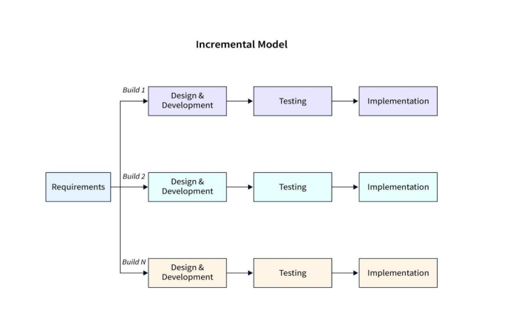
METHODOLOGY
Incremental Model used for agile delivery
App built in phases with constant user feedback
Early working modules delivered and improved over time
Notes:
Development Model "We followed the Incremental Model for development. This allowed us to roll out parts of the app progressively and gather feedback along the way, leading to better refinement and user satisfaction."

Slide 6
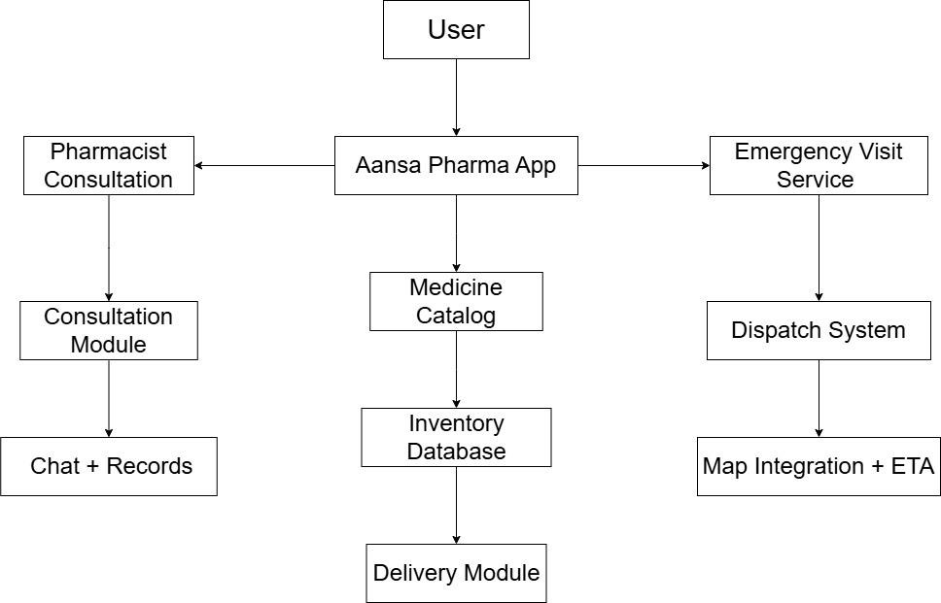
BLOCK DIAGRAM
Notes:
Technology Stack "From a technical perspective, we used Flutter for a smooth cross-platform experience. Firebase or Node.js serves the backend, and we plan to use Firestore or MySQL for databases. Google Maps is integrated for tracking home visits. The admin panel is web-based for easy management."

Slide 7
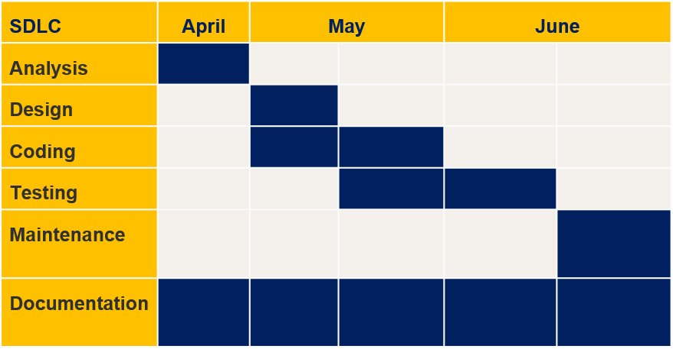
GANTT CHART
*Note: The Duration of one interval is of 15 days.
Notes:
"This Gantt chart shows our three-month timeline, divided into 15-day intervals. It includes phases like analysis, design, development, testing, and deployment. The plan ensures structured progress while allowing flexibility."

Slide 8
DELIVERABLES
A mobile application (Android/iOS) for medicine ordering and consultation.
Emergency home visit module with GPS-based dispatch.
Admin dashboard for monitoring operations and analytics.
Notification and reminder system for medicine refills.
Multilingual support (English/Nepali).
Secure user data storage and medical record handling.
Notes:
Deliverables "Our project will deliver an Android and iOS app, an admin dashboard, a verified medicine database, chat/video consultation features, and an emergency module. We also aim to integrate third-party pharmacy APIs."
Key Features "Here are the standout features of Aansa Pharma: Verified medicine orders, pharmacist consultations with gender selection, emergency home visits, and real-time tracking. Notifications for refills, record keeping, and bilingual support make it truly user-focused."

Slide 9
CONCLUSION
Aansa Pharma bridges a critical healthcare gap in Nepal.
It simplifies access to trusted pharmacy services.
The app empowers users with safe, fast, and smart health solutions.
A major step toward digital healthcare Aansa Pharma bridges a critical healthcare gap in Nepal.
Notes:
: Market Opportunity "Nepal has over 30 million people and growing smartphone users. Yet there's little to no competition in digital pharmacy services. Remote areas especially need solutions like this, and post-COVID, the demand for such apps has increased significantly."
Competitive Advantage "Unlike existing apps, Aansa Pharma offers unique services like pharmacist home visits and gender-selectable consultations. The app supports both Nepali and English, and all pharmacies are verified, ensuring trust and safety."

Slide 10
THANK YOU
DO YOU HAVE ANY QUESTIONS ?

